Slide 1

Industrial Automation Challenges in Electrical Engineering
Presented by:
Sheza Naveed 22L-7651
Sara Saif 22L-7734
Haseeb ur Rehman 22L-6234
M. Taseer Razzaq 22L-7618
BS-EE 6C.
April 21, 2025.

Slide 2
Presentation Roadmap
1
Introduction
2
Key Challenges
3
Technical Deep Dive
4
Solutions
5
Future Trends
6
Conclusion
7
Q&A

Slide 3
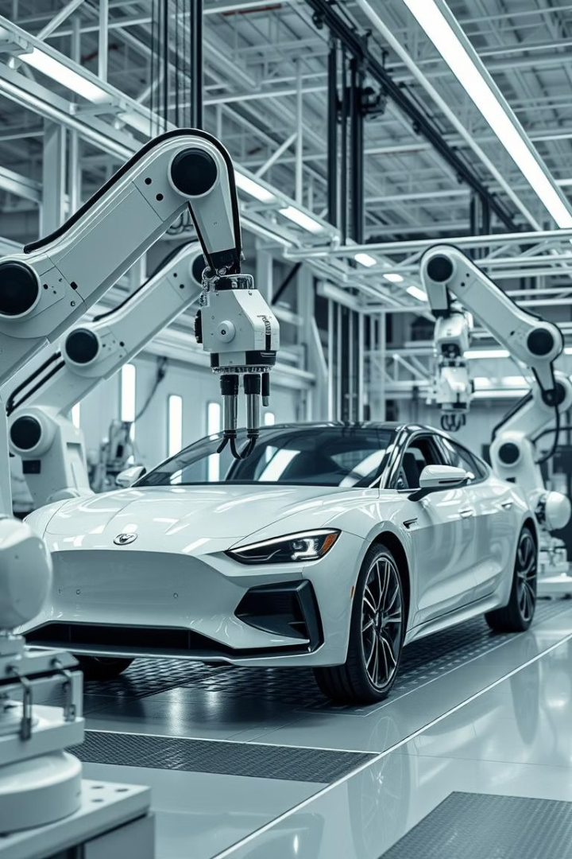
Introduction to Industrial Automation
Automation uses control systems to minimize human intervention. It enhances the efficiency of machines.
The Pakistan industrial automation market is worth ~PKR 56 billion. It shows a strong annual growth of 10-12%.
Automation in Electrical Engineering Domain plays a critical role in power, control, and instrumentation.

Slide 4
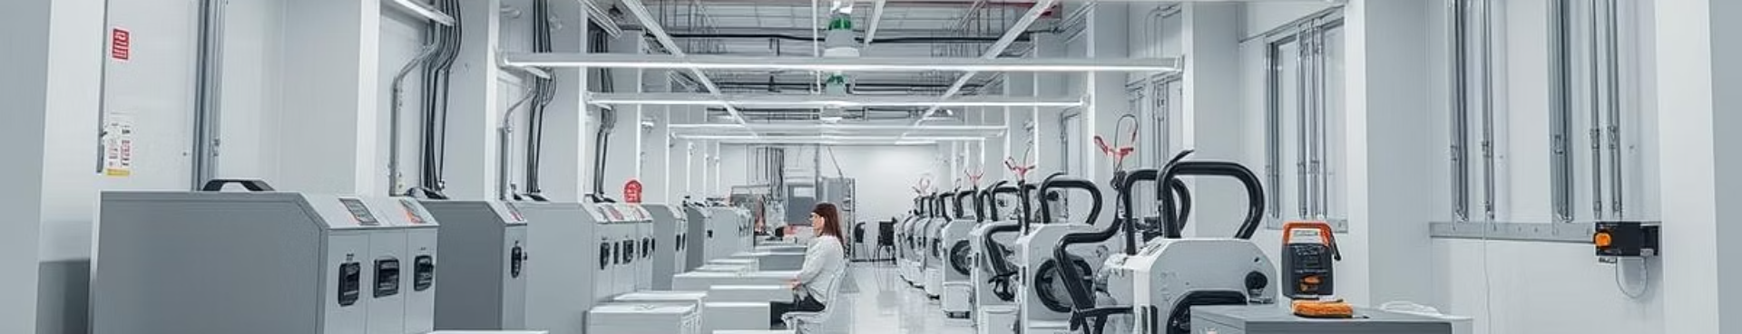




Key Challenges in Electrical Engineering
High Investment Costs
Energy Efficiency
High costs deter automation upgrades, with PKR 50-100M price tags.
Outdated systems waste 20-30% of electricity. Textile mills lose PKR 15-20M/year.
Regulatory Hurdles
Skills Gap
Outdated regulations force the use of inefficient systems.
Lack of trained personnel. Only 12 universities offer automation engineering.

Slide 5



Technical Deep Dive: Investment & Efficiency
High Investment Costs
Energy Efficiency
Upfront capital can be a barrier.
Automation can lead to higher consumption.
Requires maintenance and may suffer downtime.
Equipment may consume energy even when idle

Slide 6



Technical Deep Dive: Regulations & Skills
Regulatory Hurdles
Aging Infrastructure & Skills Gap
Must comply with strict safety regulations.
Workers lack the skills to operate systems.
Adhere to environmental rules on emissions.
Shifts traditional roles to higher-skill positions.

Slide 7










Solutions: Costs & Efficiency
Local Manufacturing
Renewable Energy Sources
1
Hybrid Solar Systems
6
3
Financing Models
Waste Heat Recovery
Smart Motor Systems

Slide 8

Solutions: Regulations & Skills
Cyber-Security
Safety Parameters
Upskilling Programs
Management Strategies

Slide 9
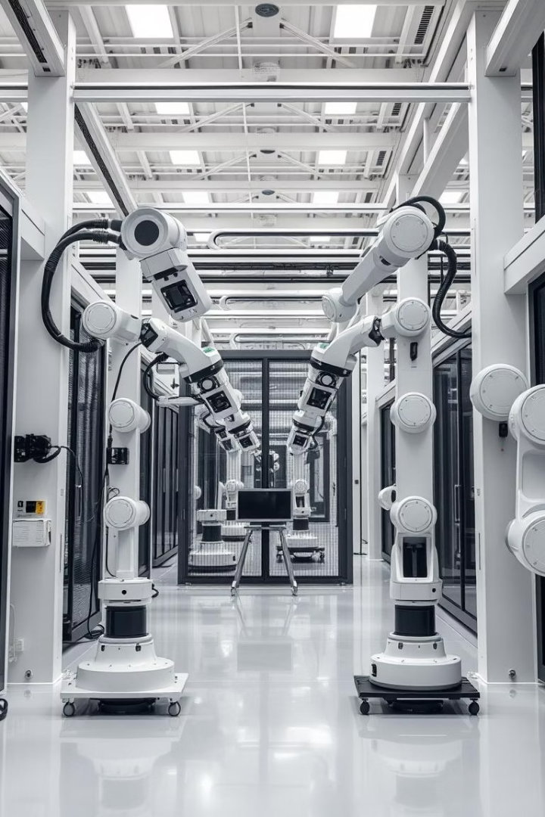
Conclusion
Pakistan needs automation but faces blocks. High costs, old machines, and slow approvals hinder progress. Fixing these problems with local tech and training will boost growth. Upgrade now—or get left behind.
Questions?
Thank you for your attention!

